Slide 1
Lecture 4 Introduction to Web Applications

Slide 2
Objectives
Websites vs Web Applications
Web Application Architecture
Create a Simple Web Application using MySQL, Tomcat, Java Servlets and JSP

Slide 3
Websites vs Web Applications
Website: everytime the users clicks on a link, the web browser generates HTTP requests and reloads the page.
Web Application: JavaScript code is used to interact with the server in the background and updates the display as needed.
Source: https://www.youtube.com/watch?v=Hv3czsQh8tg
Notes:
In a web application, the user is typically on the same web page for long periods of time, even though the display may change as they interact with the page. Rather than having the web browser generate HTTP requests and reload the page, JavaScript code is used to interact with the server in the background and update the display as needed

Slide 4
Web Application Architecture
Presentation Tier
Logic Tier
Data Tier
Database
Browser
Web/Application Server
Database Server
Each Tier can potentially run on a different machine
Presentation, logic, data tier are disconnected

Slide 5
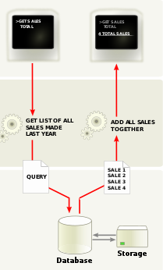
Web Application Architecture
Presentation tier
Represents the user interface. It represents requests and results in something the user can understand.
Logic tier
Cordinates the application, processes comands, makes logical decisions and evaluations, and performs calculations. It also moves and processes data between the 2 surrounding layers.
Data tier
Information is stored and retrieved from a database or file system. The information is then passed back to the logic tier for processing and then back to the user.

Slide 6
Web Application Architecture
Architectural Principles
Each tier should be independent and should not expose dependencies related to the implementation.
Disconnected tiers should not communicate.
Changes in platform should only affect the layer running that particular platform

Slide 7
Web Application Architecture
Presentation Layer
Provides user interface
Handles the interaction with the user.
Sometimes called the GUI or client view or front-end.
Should not contain business logic or data access code.

Slide 8
Web Application Architecture
Logic Layer
Implements a set of rules for processing information.
Can accommodate many users’ requests.
Sometimes called middleware/back-end.
Should not contain presentation or data access code.

Slide 9
Web Application Architecture
Data Layer
The physical storage layer for data persistence.
Manages access to DB or file system.
Sometimes called back-end.
Should not contain presentation or business logic code.

Slide 10





Web Application Architecture
Statically or dynamically generated content rendered by the browser
HTML, JavaScript
A dynamic content processing and generation level application server
A database comprising both data sets and database management system or RDBMS software

Slide 11
Tutorial E-Shop Case Study
In this case study we will develop an “e-shop” based on the Java Servlet Technology. This e-shop is a typical 3-tier application.

Slide 12
Components
Client-side programs
(HTML, JavaScript)
Presentation
Layer
Web Browser
Server-side programs
(Java Servlets)
Web Server
(Apache Tomcat Server)
Logic Layer
Custom Database
Data Layer
DBMS
(MySQL)
Notes:
The proposed ranking is based on years of experience that Gary McGraw acquired by applying touchpoints to many different types of organizations ranging from independent software vendors to huge credit card consortium

Slide 13
Step 1: Prepare the DataBase
Download and install MySQL server at
https://dev.mysql.com/downloads/mysql/
Follow the installation instructions that are specific to your platform
https://dev.mysql.com/doc/refman/8.0/en/installing.html

Slide 14
Step 1: Prepare the DataBase
Once your database server is up and running, download file script.sql available on Moodle.
script.sql will take care of the creation of the database.
You can run the script using the following commands inside mysql
mysql> source <path to your script>/script.sql
Remember to create and use a database of your choice before running the script!

Slide 15
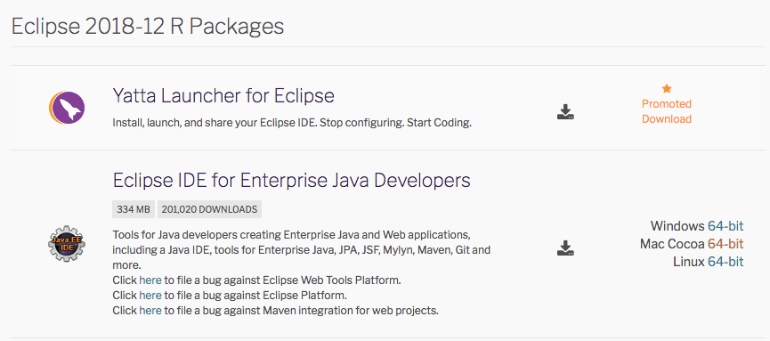
Step 2: Create a WebApp Project
First download and install the most recent version of Eclipse IDE for Enterprise Java Developers at
https://www.eclipse.org/downloads/packages/
Notes:
The user is typically on the same web page for long periods of time, even though the display may change as they interact with the page. Rather than having the web browser generate HTTP requests and reload the page, JavaScript code is used to interact with the server in the background and update the display as needed

Slide 16
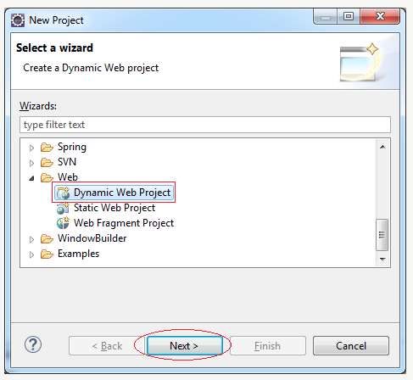
Step 2: Create a WebApp Project
In Eclipse create a new Dynamic Web Project and click Next
Set a project name (e.g., SimpleWebApp) and press Next
Click Next in the next screen.

Slide 17
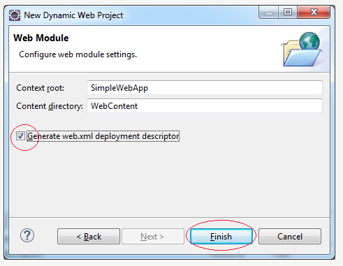
Step 2: Create a WebApp Project
Select Generate web.xml deployment descriptor
Click Finish
Notes:
The user is typically on the same web page for long periods of time, even though the display may change as they interact with the page. Rather than having the web browser generate HTTP requests and reload the page, JavaScript code is used to interact with the server in the background and update the display as needed

Slide 18
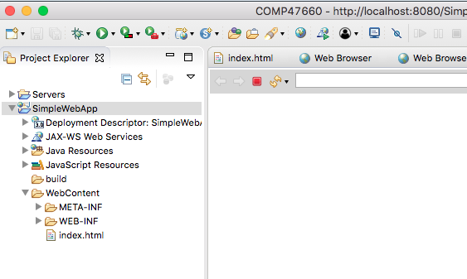
Step 2: Create a WebApp Project
The project is now created

Slide 19
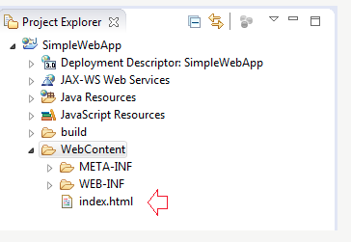
Step 2: Create a WebApp Project
Add file index.html (provided in Moodle)
Notes:
The user is typically on the same web page for long periods of time, even though the display may change as they interact with the page. Rather than having the web browser generate HTTP requests and reload the page, JavaScript code is used to interact with the server in the background and update the display as needed

Slide 20
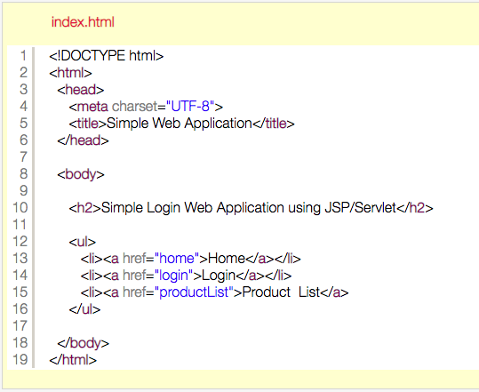
Step 2: Create a WebApp Project

Slide 21
Step 3: Configure the Web Server
Remember that your application needs to run on a Web Server, such as Tomcat Server
Thus the first thing you need to do is to install the most recent version of Tomcat.
I installed version 9
https://tomcat.apache.org/download-90.cgi
You can download the installer if you are a Win user or just decompress the archive (.zip or .tar.gz) if you are a Linux or a MacOS user
Notes:
The user is typically on the same web page for long periods of time, even though the display may change as they interact with the page. Rather than having the web browser generate HTTP requests and reload the page, JavaScript code is used to interact with the server in the background and update the display as needed

Slide 22
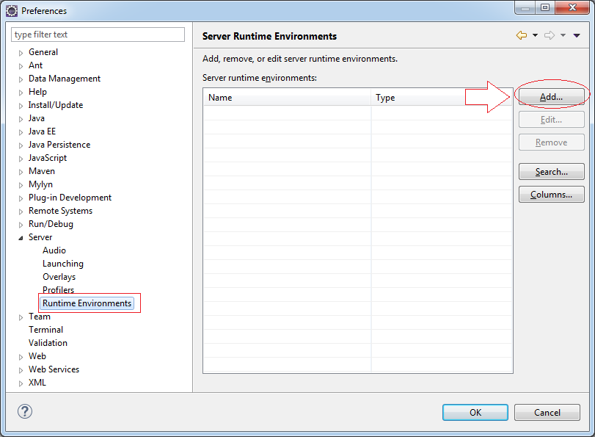
Step 3: Configure the Web Server
Select: Eclipse >> Preferences
Notes:
The user is typically on the same web page for long periods of time, even though the display may change as they interact with the page. Rather than having the web browser generate HTTP requests and reload the page, JavaScript code is used to interact with the server in the background and update the display as needed

Slide 23
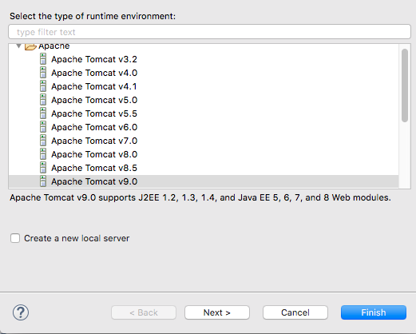
Step 3: Configure the Web Server
Notes:
The user is typically on the same web page for long periods of time, even though the display may change as they interact with the page. Rather than having the web browser generate HTTP requests and reload the page, JavaScript code is used to interact with the server in the background and update the display as needed

Slide 24
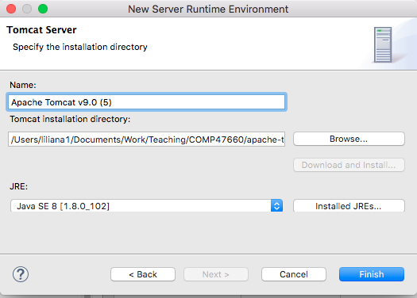
Step 3: Configure the Web Server
Tomcat Installation directory
Select Java 8
Notes:
The user is typically on the same web page for long periods of time, even though the display may change as they interact with the page. Rather than having the web browser generate HTTP requests and reload the page, JavaScript code is used to interact with the server in the background and update the display as needed

Slide 25
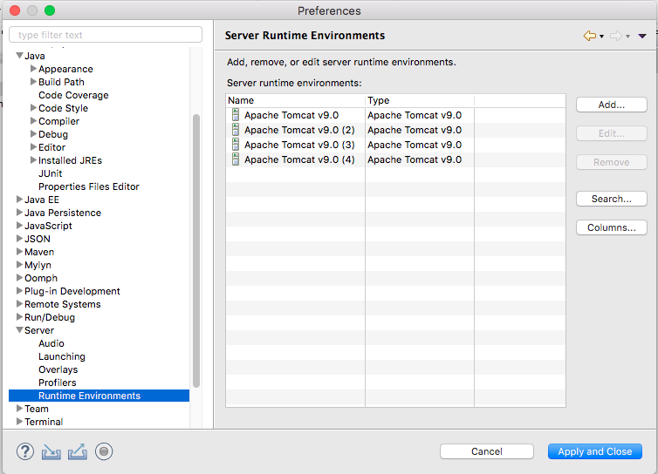
Step 3: Configure the Web Server
Notes:
The user is typically on the same web page for long periods of time, even though the display may change as they interact with the page. Rather than having the web browser generate HTTP requests and reload the page, JavaScript code is used to interact with the server in the background and update the display as needed

Slide 26
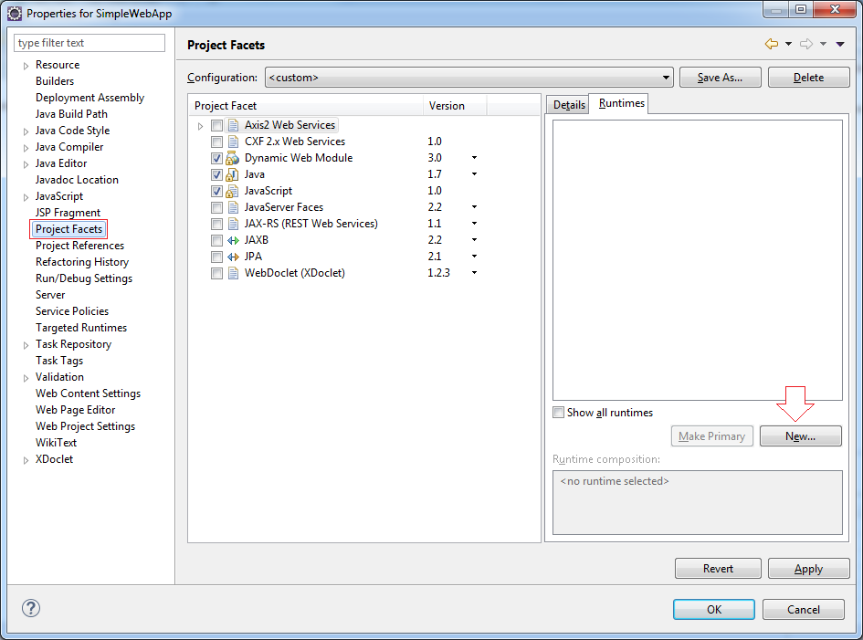
Step 3: Configure the Web Server
Right click on SimpleWebApp and select Properties
Notes:
The user is typically on the same web page for long periods of time, even though the display may change as they interact with the page. Rather than having the web browser generate HTTP requests and reload the page, JavaScript code is used to interact with the server in the background and update the display as needed

Slide 27
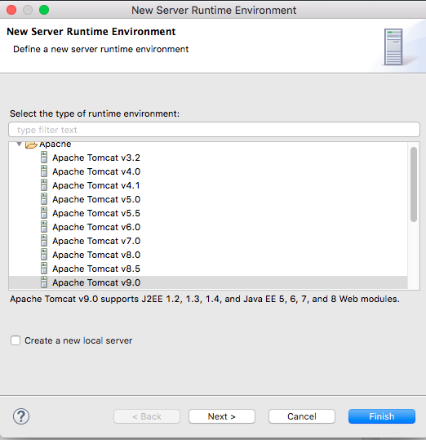
Step 3: Configure the Web Server
Notes:
The user is typically on the same web page for long periods of time, even though the display may change as they interact with the page. Rather than having the web browser generate HTTP requests and reload the page, JavaScript code is used to interact with the server in the background and update the display as needed

Slide 28
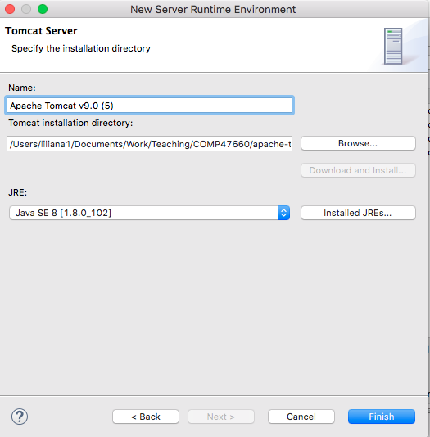
Step 3: Configure the Web Server
Tomcat Installation directory
Select Java 8
Notes:
The user is typically on the same web page for long periods of time, even though the display may change as they interact with the page. Rather than having the web browser generate HTTP requests and reload the page, JavaScript code is used to interact with the server in the background and update the display as needed

Slide 29
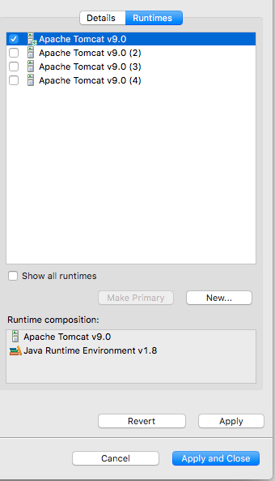
Notes:
The user is typically on the same web page for long periods of time, even though the display may change as they interact with the page. Rather than having the web browser generate HTTP requests and reload the page, JavaScript code is used to interact with the server in the background and update the display as needed

Slide 30
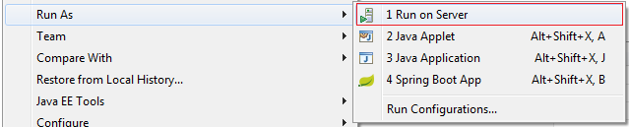
Step 4: Run the Web Application for the First Time
Right click on SimpleWebApp and select Run As
Notes:
The user is typically on the same web page for long periods of time, even though the display may change as they interact with the page. Rather than having the web browser generate HTTP requests and reload the page, JavaScript code is used to interact with the server in the background and update the display as needed

Slide 31
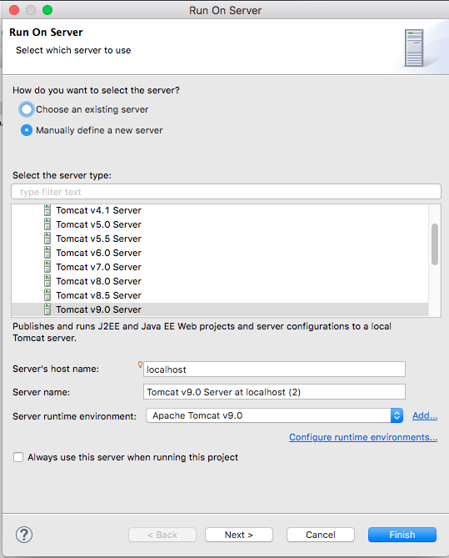
Manually define a new server.
Notes:
The user is typically on the same web page for long periods of time, even though the display may change as they interact with the page. Rather than having the web browser generate HTTP requests and reload the page, JavaScript code is used to interact with the server in the background and update the display as needed

Slide 32
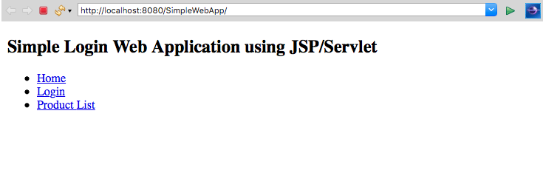
Your first web application is now up and running!

Slide 33
Step 5: Include Additional Libraries
JDBC Library: supports connectivity with the database.
A different driver will need to be used for different DBMS
Download the JDBC driver for MySQL here:
https://mvnrepository.com/artifact/mysql/mysql-connector-java

Slide 34
Step 5: Include Additional Libraries
JSP Standard Tag Library (JSTL): it is a components of the Java EE Web Application development platform. It extends the JSP specification by adding a tag library of JSP tags for common tasks, such as XML data processing, conditional execution, loops.
You need to download 2 JSTL libraries to be able to use them in JSP
javax.servlet.jsp.jstl-*.jar
javax.servlet.jsp.jslt-api-*.jar
Add libraries in the WebContent/WEB-INF/lib folder inside your project

